Slide 1
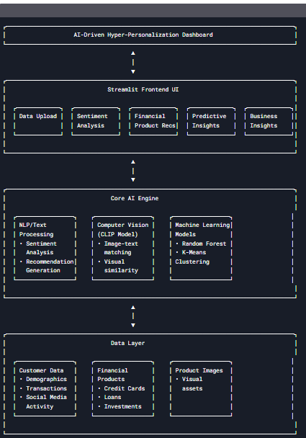
Architecture diagram of AI for Hyper-Personalization & Recommendations

Slide 2
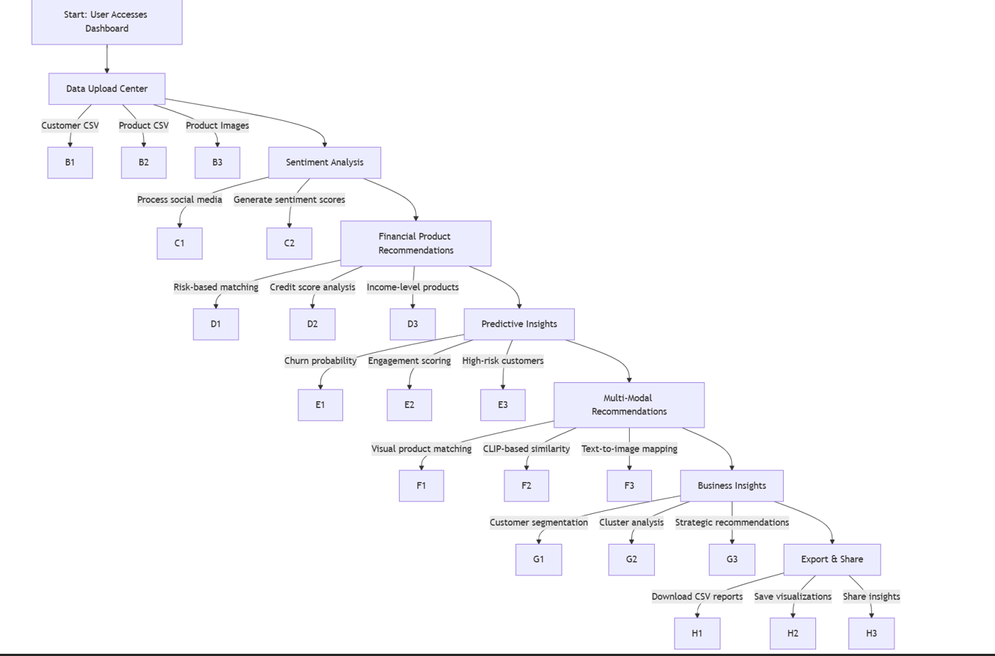
User Flow diagram

Slide 3
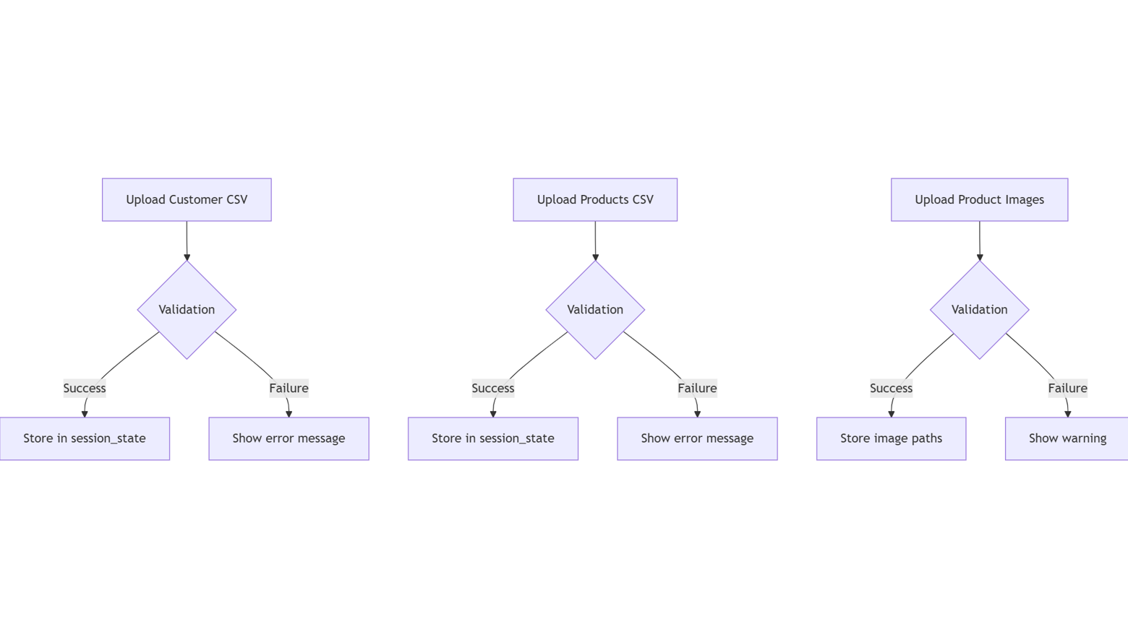
DATA Upload Flow Diagram

Slide 4
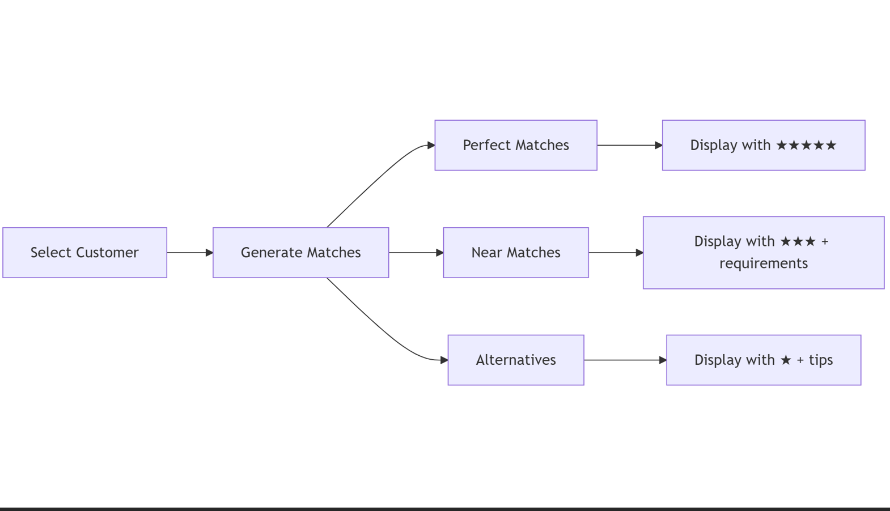
Recommendations engine flow diagram

